Slide 1
The Solar System – Viking Fun Facts!
This is a document for fun facts that go with each question in my Solar System Kahoot. Each slide is for each question. Enjoy!

Slide 2
Question 1- 8 Planets
There are 8 planets in our solar system
Mercury
Venus
Earth
Mars
Jupiter
Saturn
Uranus
Neptune

Slide 3
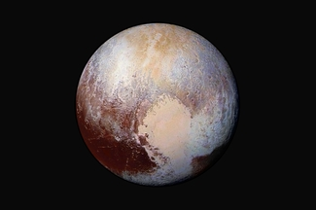
Question 2- Pluto
In 2006, the International Astronomical Union (IAU) classified Pluto as a dwarf planet, due to the discovery of other similar objects that weren’t considered planets

Slide 4
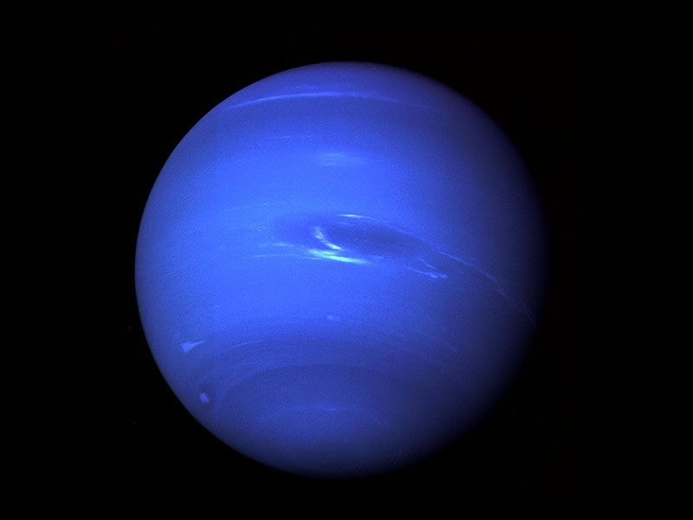
Question 3- Roman Gods
All the planets, except one planet was named after Roman Gods

Slide 5
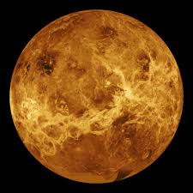
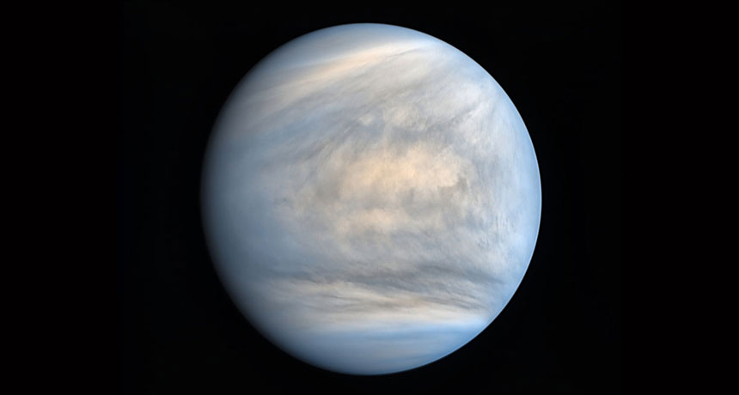
Question 4- Venus
Venus is the second-brightest natural object in our night sky, after the moon and can seen during daylight as well, but only rarely

Slide 6
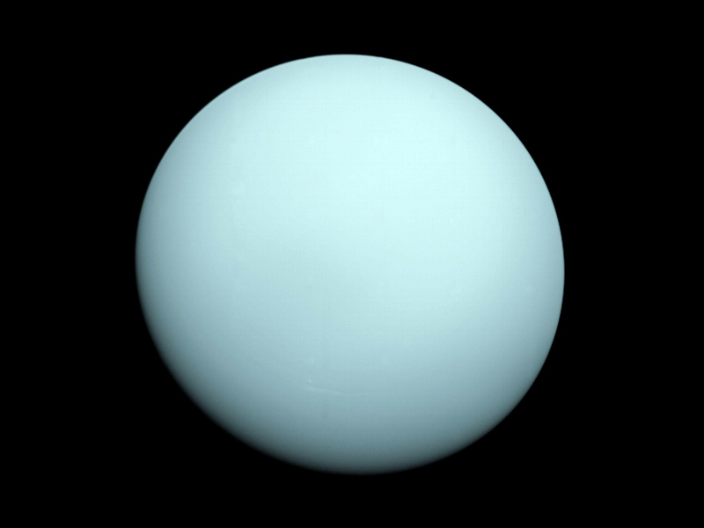
Question 5- Uranus
Uranus was named after the Greek God of the Sky. He is however connected to the Roman Gods, associated with the Roman God Caelus

Slide 7
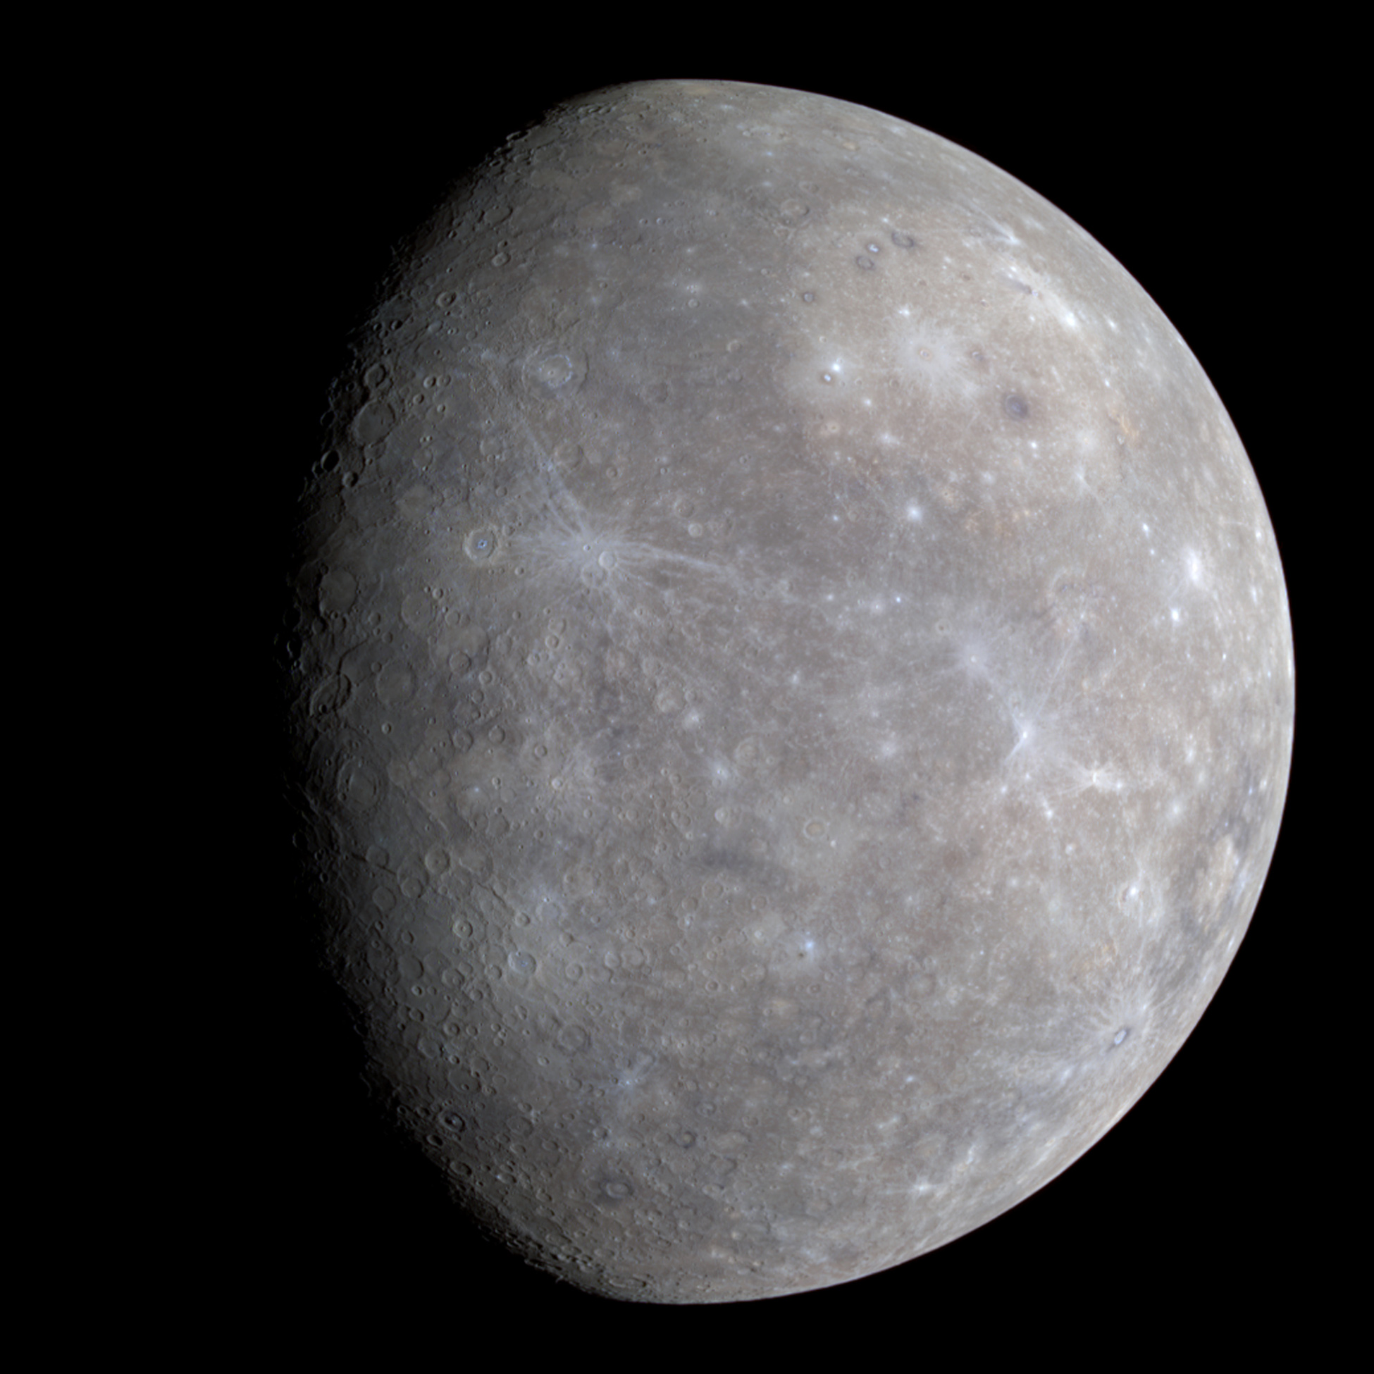
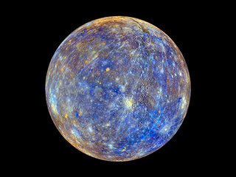
Question 6- Mercury
Mercury is the closest to the sun, making it very much scorched by the sun and making the terrain very similar to that of our moon

Slide 8

Question 7- Neptune
Neptune is the farthest from our sun (not including dwarf planets), being almost 3 billion miles away from the sun. It is also the coldest planet, being -330 degrees Fahrenheit.

Slide 9
Question 8- Venus
Venus takes 243 Earth days to complete one rotation on its axis. Since it takes 225 Earth Days to complete one year, this means that years are quicker than days

Slide 10
Question 9- Neptune
Neptune takes 90,530 Earth Days (248 Earth Years) to complete one orbit around the sun

Slide 11
Question 10- Venus
Venuses average temperature 864 degrees Fahrenheit, being almost 100 degrees warmer than Mercury

Slide 12
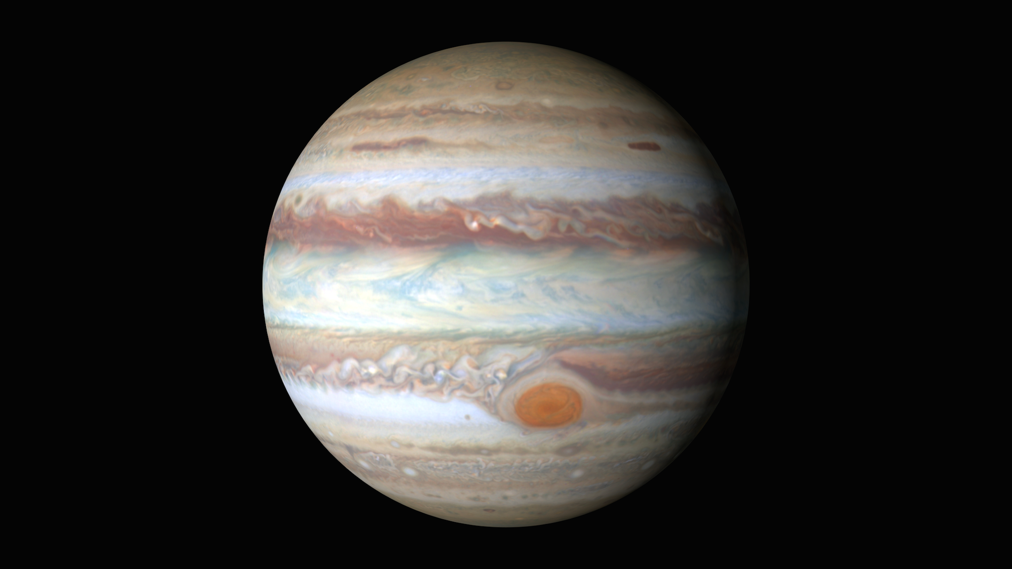
Question 11- Jupiter
Jupiter is the largest planet in our solar system. If Earth was the size of a grape, Jupiter would be a basketball. Jupiter also has the quickest days In our solar system and, known as Jovian days, each day there is only 10 hours long. 1 Jupiter year is 12 Earth years

Slide 13
Question 12- Venus
Venuses atmosphere consists of mainly Sulfuric Acid. The Surface is about 80% of smooth volcanic plains. There is evidence of very recent volcanic Activity too

Slide 14
Question 13- Uranus
Uranus is tilted about 98 degrees on its axis, making the planet literally sideways. This also cause the planet to have interesting seasons

Slide 15
Question 14- A planet mainly composed of Hydrogen and Helium
Gas giants are planets that are mainly composed of Hydrogen and Helium

Slide 16
Question 15- A planet mainly composed of heavier elements than hydrogen and Helium
Ice giants are planets that are mainly composed elements heavier than Hydrogen and Helium, such as Oxygen, Carbon, Nitrogen and sulfur

Slide 17
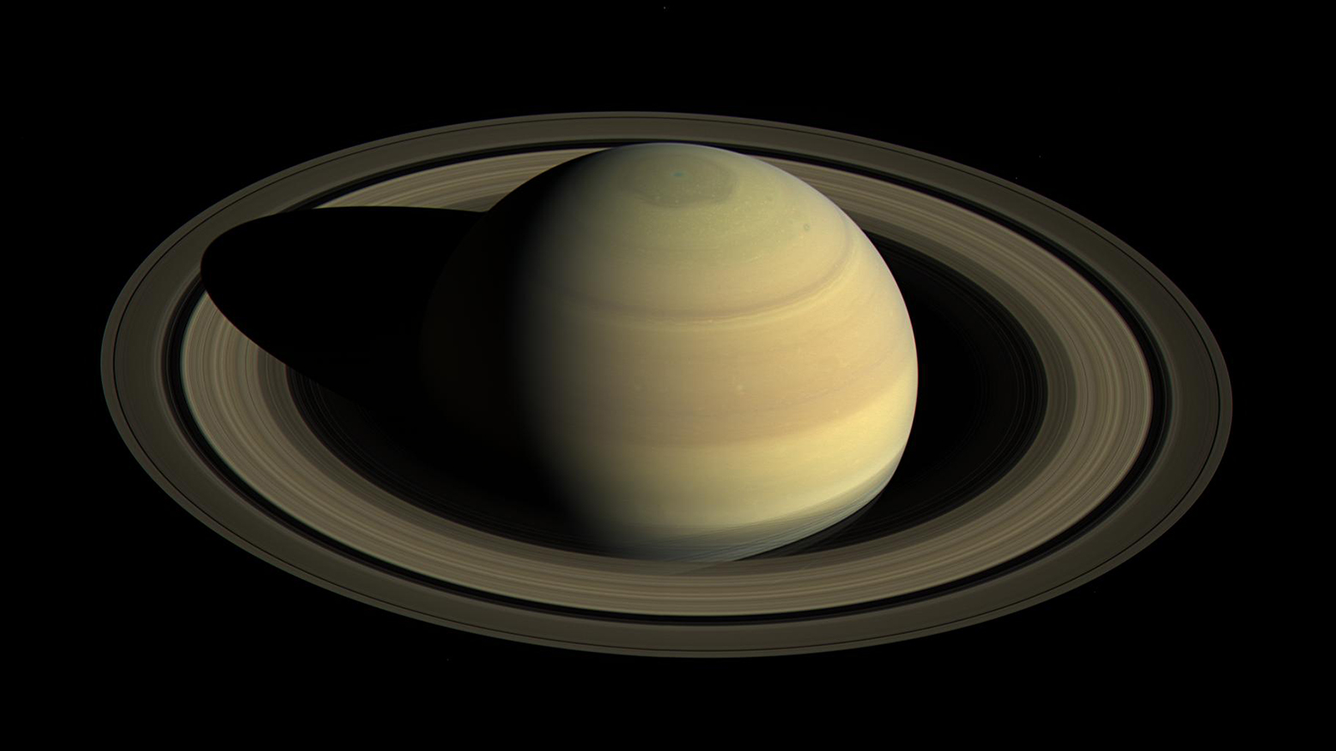
Question 16- Jupiter & Saturn
Jupiter is made of Hydrogen and Helium while Saturn is mainly made of metal and liquid Hydrogen and liquid Helium. Since Uranus and Neptune both happen to be mainly made of Hydrogen and Helium along with their ices, they are technically considered Gas giants as well

Slide 18
Question 17- Uranus & Neptune
Uranus and Neptune are both mainly made of Hydrogen, Helium, Water ice, Ammonia ice and Methane ice

Slide 19
Question 18- 4
Saturn may have the most notable rings, but it isn’t the only planet with them. Jupiter, Uranus and Neptune also have rings, but they’re quite thin, making harder to see

Slide 20
Question 19- Uranus
Uranus has 13 rings. However, because of it’s axis, the rings go around the planet vertically

Slide 21
Question 20- Jupiter
Jupiter has 79 moons, most likely due to Jupiter's very strong gravity. 63 of these moons are less 10 kilometers (6 miles) in diameter, and only 51 have been named

Slide 22
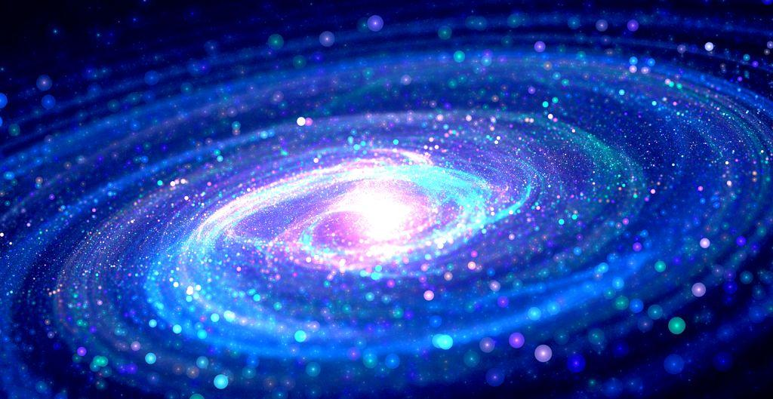
Question 20- The Milky Way
Our Solar System is in the Milky Way Galaxy. Our Solar System is probably less than 1% of the whole Galaxy, so we have much to explore. Andromeda is the closest Galaxy to ours
P.s, if you understood the ‘Sanghelios’ reference, you are an amazing person

Slide 23
Question 19- YUR-UH-NIS
Come on people… it’s so simple. YUR. UH. NIS. Why would someone even name a planet that? Just, no. Stop it. Fix yourself

